Slide 1


Easovation Solutions
Your Partner in Smart POS Technology
A Comprehensive Overview of Retail Innovation
Ahmedabad, Gujarat, India

Slide 2

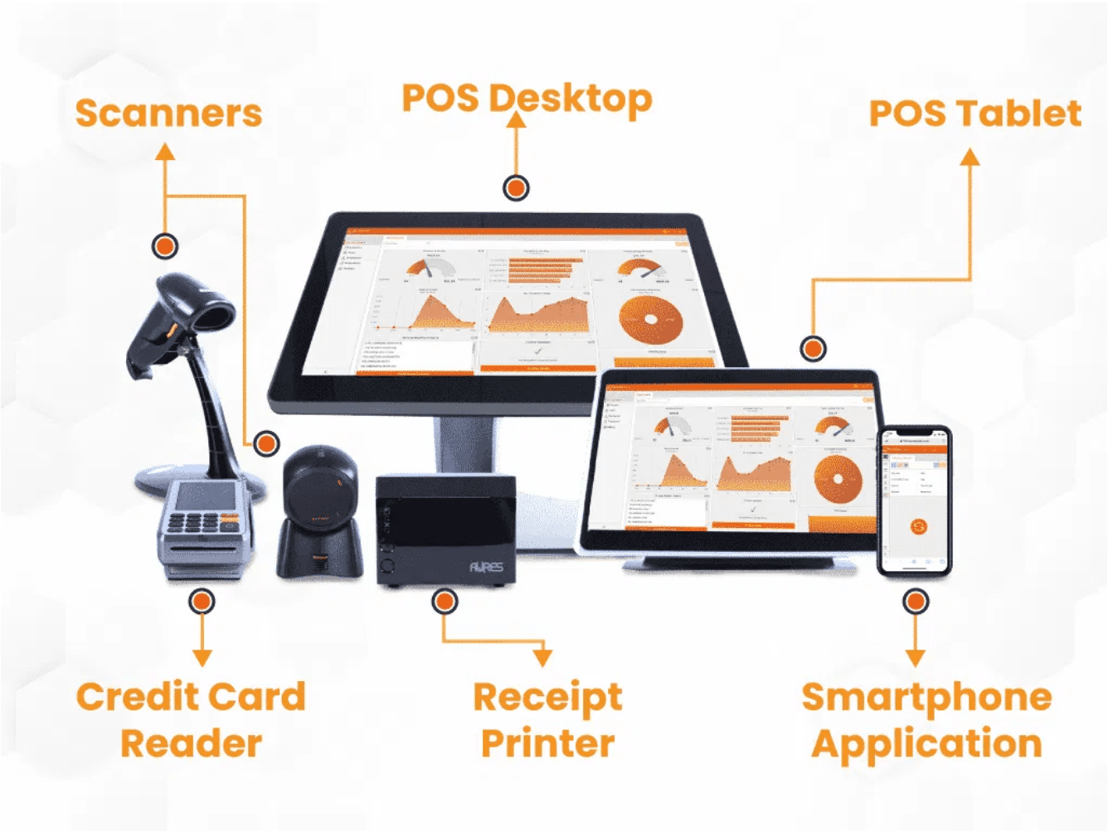
Key Offerings: A Complete POS Ecosystem
Comprehensive Solutions: Software & Hardware
Software Solutions
Hardware Solutions
▸
Mobile-Based POS
▸
POS Hardware
Enables transactions directly on the shop floor to beat queues and enhance customer engagement.
Supplies peripherals including Thermal Printers, Barcode Scanners, and Cash Drawers.
▸
Smart Android Apps
▸
Specialized Retail POS
Tailor-made POS apps for Android tablets, ideal for Cafes, Bakeries, and Restaurants.
Solutions for Supermarkets, Provision Stores, and Garment/Clothing outlets.
▸
Integrated Ecosystem
▸
Diverse POS Systems
Seamless integration of software and hardware for complete business solutions.
Android Touch POS, Windows Touch POS, and All-in-One units for various business needs.

Slide 3

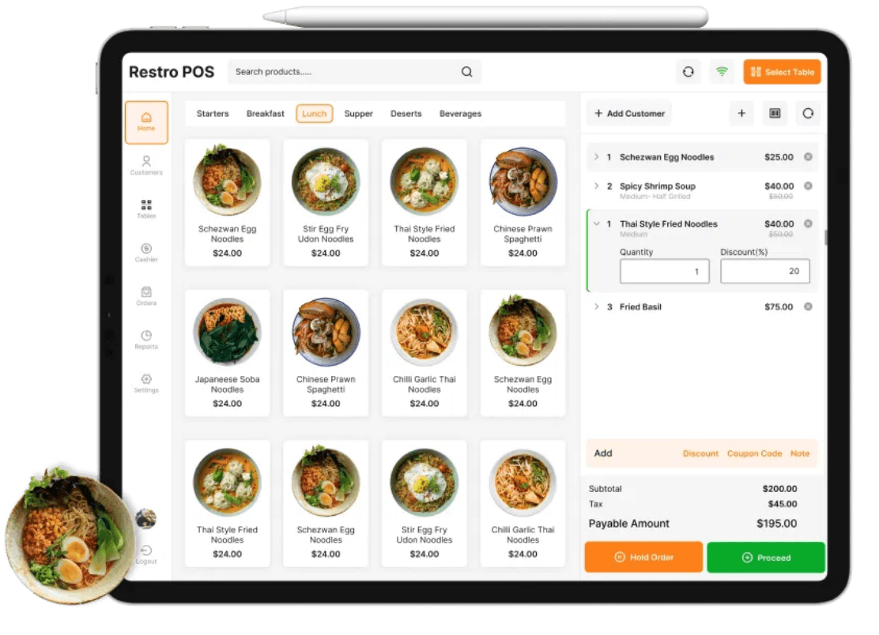
Features & Benefits: The Easovation Advantage
Smart, Simple, and Trackable Operations
1
Easy To Use Interface
2
Highly Customizable
Simple design with quick key assignment for faster, more accurate order processing.
User interface can be designed to reflect your shop's unique identity and product selection.
3
Trackable & Accountable
4
Speed and Efficiency
Records all register activity and orders by staff member for easy review and custom reporting.
Designed for quick transactions, minimizing wait times and maximizing customer satisfaction.
5
Dedicated Support
Fully dedicated customer support ensures smooth operation and quick resolution of any queries.

Slide 4

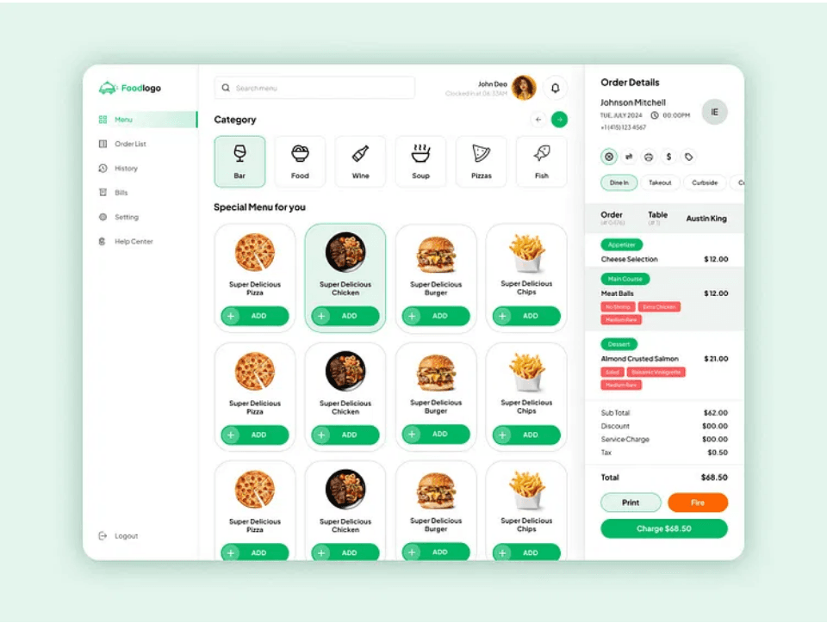
Use Cases: Tailored Solutions for Every Business
Specialized POS for Retail and Hospitality
Hospitality & Food Service
Retail & Grocery
▸
Restaurant Management
▸
Supermarkets
Full software with KOT (Kitchen Order Ticket) System for efficient order management.
Specialized billing solutions for high-volume supermarket operations.
▸
Mobile Ordering
▸
Specialty Retail
Captain Ordering on Tablet and seamless Online Food Ordering System integration.
Dedicated POS for Sweets Marts, Fruits & Vegetables, and Clothing/Garment Stores.
▸
Fast Food Outlets
▸
Provision Stores
Optimized POS for quick-service restaurants with rapid transaction processing.
Comprehensive billing solutions for grocery and provision store management.

Slide 5

Latest Updates: Embracing Modern Mobility
Focus on Mobile and Online Capabilities
Mobile-First Strategy
Core focus on Mobile-Based POS and Android Tablet compatibility for flexible, on-the-go business operations that adapt to modern retail environments.
Online Ordering Integration
Seamlessly connects physical stores with an Online Food Ordering System to expand market reach and capture digital-first customer segments.
Advanced Hardware Integration
Continuous integration of modern POS hardware from top brands (SUNMI, GPRINTER, RETSOL) for future-proof performance and reliability.
No-PC Solutions
Offering space-saving POS systems that do not require traditional PC setup, reducing infrastructure costs and operational complexity.

Slide 6

Conclusion: Partner with Easovation for Growth
Upgrade Your Business Operations
Complete Ecosystem
Provides a single source for both powerful POS software and reliable hardware solutions.
Efficiency Driver
The easy-to-use and fast system drives operational efficiency and reduces transaction times.
Customer Engagement
Mobile POS capabilities allow staff to engage customers directly on the shop floor.
Trusted Partner
Supported by dedicated customer service and trusted by happy clients across various sectors.
Ready to Transform Your Business?
Upgrade to a smart, mobile-ready POS solution and enhance your business's operational excellence today.

Slide 7

Company Profile: Easovation Solutions
Easovation Solutions
POS Solution Provider – Software & Hardware
Mission & Vision
To be the preferred POS solution provider by delivering simple, smart, and efficient software and hardware that enables retail and hospitality businesses to thrive through enhanced mobility and operational excellence.
Core Services
▸
POS Software Development & Customization
▸
POS Hardware Supply & Integration
▸
Dedicated Customer Support & Maintenance
Contact Information
Location
Website
Ahmedabad (GUJARAT) - INDIA
www.easovation.com
Email
Phone
easovation@gmail.com
+91 9624045500
© Easovation Solutions. All Rights Reserved.

